Slide 1
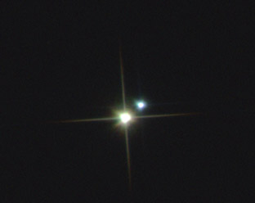
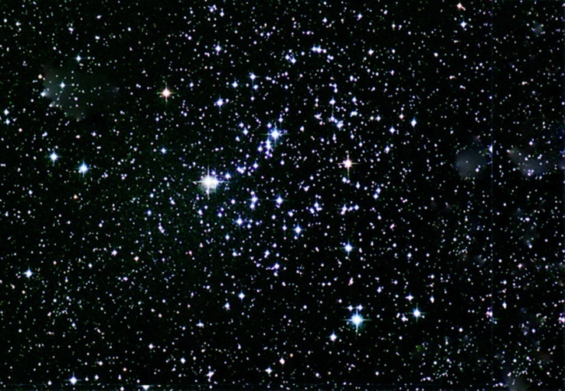
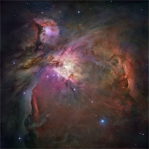

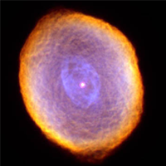

Slide 2

Iota Cancri
Through The Telescope
When seen through a telescope, It’s not one star but two! One star is yellow, and the other is blue.

Slide 3
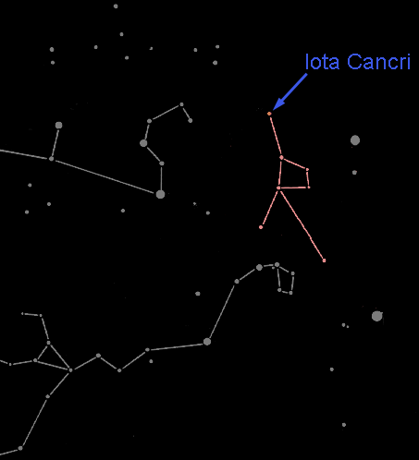
Iota Cancri In The Night Sky
This star pair is in the dim constellation of Cancer the Crab.

Slide 4
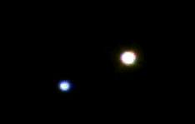

Star Pairs
Pairs of stars come in two varieties:
Optical Double Stars
Binary Stars

Slide 5

Optical Double Stars
Optical double stars are two stars that happen to lie in the same direction in the sky.
(A side view)
If you could see these stars from somewhere in space other than Earth, you would see that they have nothing to do with each other.

Slide 6
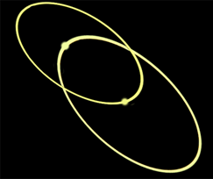

Binary or Multiple Stars
In a Binary (or Multiple) star system the stars are relatively close together and orbit each other.

Slide 7
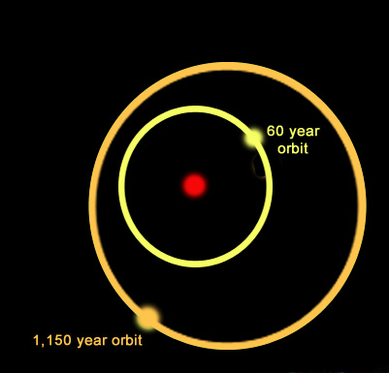
Multiple Star Systems
Multiple star systems come in many varieties. The system shown here is a triple star system:
A yellow star orbits a primary star with a period of nearly 60 years while a more distant companion orbits the inner pair with a period of 1,150 years.
One multiple star system we know of has 9 stars!

Slide 8

Multiple or Optical Double?
It's all in the distance.
Optical double stars are very large distances apart but appear to be close together because they are in the same line-of-sight.
Multiple stars lie close to each other in space and at about the same distance from Earth.

Slide 9
How Can You Find the Distance to a Star?
Earth
Nearby star
ρ
Background stars
Sun
d
ρ
Apparent positions of the nearby star for observations taken 6 months apart.
The position of a nearby star from different sides of our orbit around the Sun make it seem to shift in the sky. This shift, called parallax, can be used to find the distance to nearby stars.

Slide 10
Iota Cancri
Contrast Optical Double Star
We have found the distances to these two stars: The blue star is 188 light years from us, and the yellow star is 298 light years away.
The stars are separated by 110 light years! So they do not orbit each other and are not a binary system.

Slide 11
Stars Can Be Different Colors
Stars form with different amounts of hydrogen. High-mass stars have lots of hydrogen so they burn hotter and faster than stars with less fuel.
Thus high-mass stars have different temperatures, colors and life-spans than low-mass stars.

Slide 12
Contrast Multiple Stars
A multiple star system can have different colored stars. Here is one with a blue star and a yellow star
Blue stars are more massive and hotter than yellow or red stars. Stars of different masses evolve differently.

Slide 13
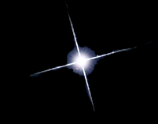

Types of Middle-Aged Stars
Blue stars are
high-mass hot stars.
Yellow stars, similar to our Sun, are average in mass and temperature.
Red stars are
low mass and cool.

Slide 14
Contrast Multiple Stars
Can you identify:
Which star is brightest?
Which star is hottest?
Which star is largest?

Slide 15
Contrast Multiple Stars
In the case of Iota Cancri, the blue star is the hotter of the two, yet the yellow star is the brightest and the largest.

Slide 16
Contrast Multiple Stars
But wait … how can the yellow star be brighter if it’s putting out less heat?

Slide 17
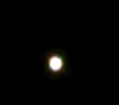
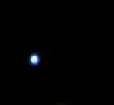
How can that be?
There are two possibilities: The cooler yellow star may be nearer to us … or it may be larger than the hotter blue star.

Slide 18
Contrast Optical Double Stars
In the case of Iota Cancri, the yellow star is almost twice as far away from us as the blue star.
Since the yellow star is brighter, then it must also be larger than the blue one.
The yellow star is starting to die, which has caused it to expand.

